Slide 1
RCropStat Screen Shots for
Analyze Menu
for Java reimplementation

Slide 2
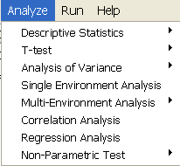
Analyze Menu
Will not be included in the re-implementation
…
…

Slide 3
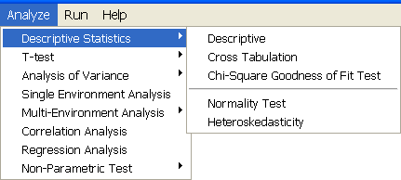
Descriptive Statistics Submenu
…
…
…
…
Not yet implemented in RCropStat

Slide 4
Descriptive Statistics
Descriptive

Slide 5
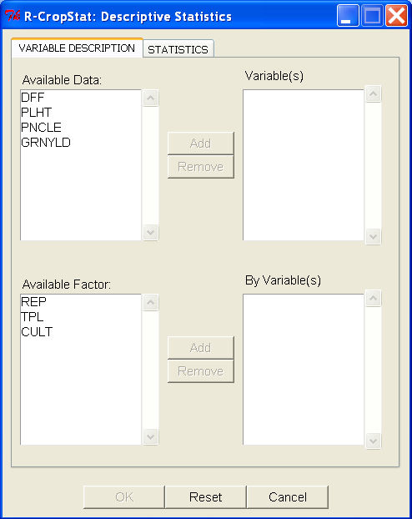
Descriptive:
Variable Description Tab
Only items in the Available Data should be transferred here; allow multiple selection; if user select item(s) here the variable’s button will be enabled with label Remove
Change label to: Numeric Variable(s):
Only numeric variables should be displayed here; allow multiple selection; if user select item(s) here the variable’s button will be enabled with label Add
Use only one button with initial label Add. Initially, the buttons are disabled.
Change label to: Factor(s):
Only items in the Available Factor should be transferred here; allow multiple selection; if user select item(s) here the by variable’s button will be enabled with label Remove
Only factor variables should be displayed here; allow multiple selection; if user select item(s) here the by variable’s button will be enabled with label Add

Slide 6
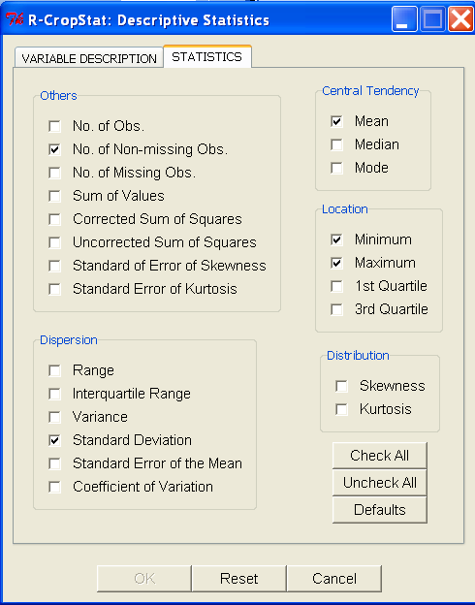
Descriptive:
Statistics Tab
If the user click Check All button, all checkbox will be check.
If the user click Uncheck All button, all checkbox will be uncheck and the OK button will be disabled.
If the user click Defaults button, the default statistics checkbox will be check.
Change the case the tab label to Title Case
Default statistics that are check: No. of Non-missing obs., Mean, Standard Deviation, Minimum, Maximum
Initially this button is disabled; it will be enabled if there is at least one item in the Variable(s) dialog box (located in the Variable Description tab) and at least one item in the Statistics tab is chooesen
Initially this button is disabled; It will be enabled if the user makes changes in the two tabs.

Slide 7
Descriptive Statistics
Cross Tabulation

Slide 8
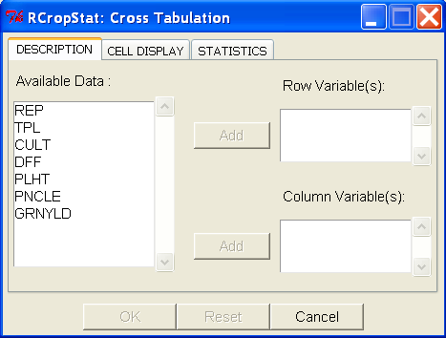
Cross Tabulation:
Variable Description Tab
allow multiple selection; if user select item(s) here the row variable’s button will be enabled with label Remove
All variables in the data set should be displayed here; allow multiple selection; if user select item(s) here the Row Variable(s) and Column Variable(s) button should be enabled with label Add
allow multiple selection; if user select item(s) here the column variable’s button will be enabled with label Remove

Slide 9
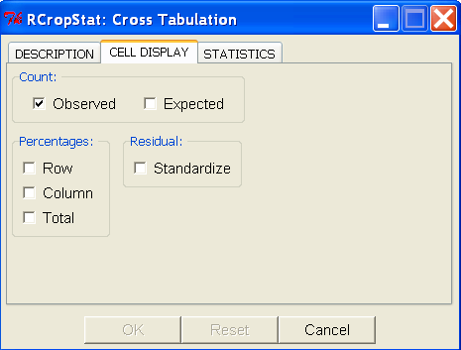
Cross Tabulation:
Cell Display Tab

Slide 10
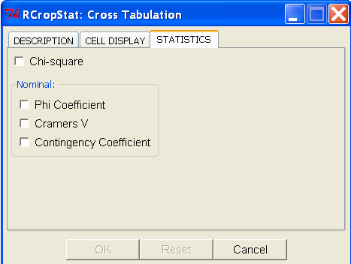
Cross Tabulation:
Statistics Tab
Default is disabled, if at least one item in the Row Variable(s) dialog box, at least one item in the Column Variable(s) dialog box and at least one checkbox is tick in the cell display and/or statistics tab, then the button will be enabled

Slide 11
Descriptive Statistics
Test for Normality

Slide 12
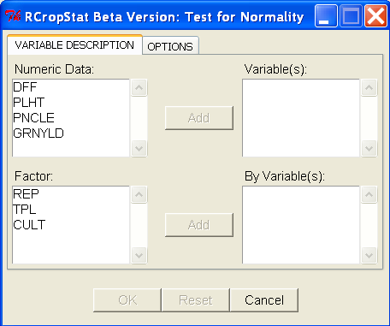
Test for Normality:
Variable Description Tab
Change case of the tab label to Title Case
Only items in the Numeric Data should be transferred here; allow multiple selection; if user select item(s) here the variable’s button will be enabled with label Remove
Change label to: Numeric Variable(s):
Only numeric variables should be displayed here; allow multiple selection; if user select item(s) here the variable’s button will be enabled with label Add
Use only one button with initial label Add. Initially, the buttons are disabled.
Only items in the Factor should be transferred here; allow multiple selection; if user select item(s) here the by variable’s button will be enabled with label Remove
Change label to: Factor(s):
Only factor variables should be displayed here; allow multiple selection; if user select item(s) here the by variable’s button will be enabled with label Add

Slide 13
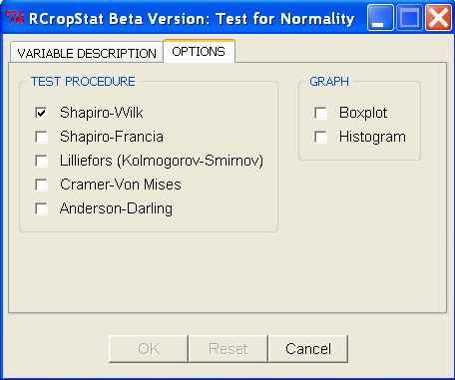
Test for Normality:
Options Tab
Initial state of is disabled; it will be enabled if there is a change from the initial display
Initial state is disabled; it will be enabled if at there is least one item in the Variable(s) dialog box (located in the 1st tab) and at least one item in the Test Procedure checked

Slide 14
Descriptive Statistics
Heteroskedasticity

Slide 15
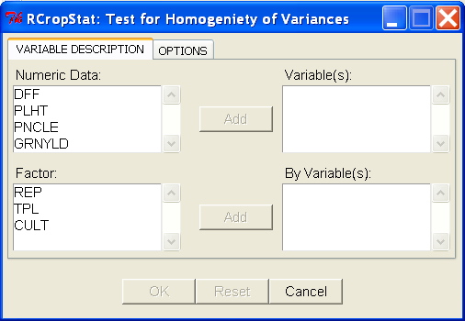
Heteroskedasticity:
Variable Description Tab
Change case of the tab label to Title Case
Only items in the Numeric Data should be transferred here; allow multiple selection; if user select item(s) here the variable’s button will be enabled with label Remove
Change label to Numeric Variable(s):
Only numeric variables should be displayed here; allow multiple selection; if user select item(s) here the variable’s button will be enabled with label Add
Use only one button with initial label Add. Initially, the buttons are disabled.
Change label to Factor(s):
Only factor variables should be displayed here; allow multiple selection; if user select item(s) here the by variable’s button will be enabled with label Add
Only items in the Factor should be transferred here; allow multiple selection; if user select item(s) here the by variable’s button will be enabled with label Remove

Slide 16
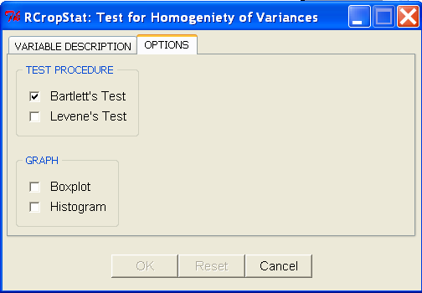
Heteroskedasticity:
Options Tab
Initial state is disabled; it will be enabled if at there is least one item in the Variable(s) dialog box and at least one item in the By Variable(s) dialog box (both located in the 1st tab) and at least one item in the Test Procedure checked
Initial state is disabled; it will be enabled if there is a change from the initial display

Slide 17
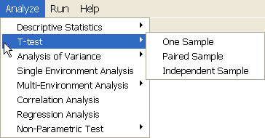
t-test Submenu
…
…
…
Change to t-test

Slide 18
t-test
One Sample

Slide 19
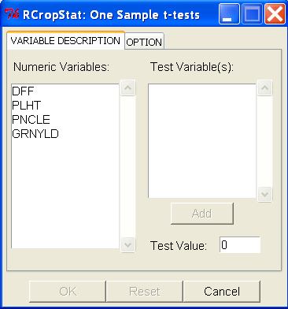
One Sample:
Variable Description Tab
Change case of the tab label to Title Case
Change label to Numeric Variable(s):
allow multiple selection; if user select item(s) here the variable’s button will be enabled with label Remove
Only numeric variables should be displayed here; allow multiple selection; if user select item(s) here the variable’s button will be enabled with label Add
Use only one button with initial label Add. Initially, the buttons are disabled.
User input
Valid Value: numeric

Slide 20
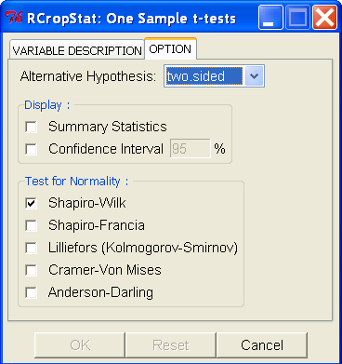

One Sample:
Options Tab
NOTE: If the user deleted the value in the Test Value entry box, default value will be used
Possible values
for Alternative
Hypothesis:
Initially disabled; will be enabled if the checkbox is ticked; default value is 95; Valid values is between 90 to 99
Initial state is disabled; it will be enabled if at there is least one item in the Test Variable(s) dialog box (located in the 1st tab)
Initial state is disabled; it will be enabled if there is a change from the initial display

Slide 21
t-test
Paired Sample

Slide 22
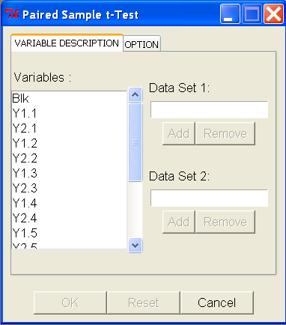
Paired Sample:
Variable Description Tab
Use only one button with initial label Add. Initially, the buttons are disabled.

Slide 23
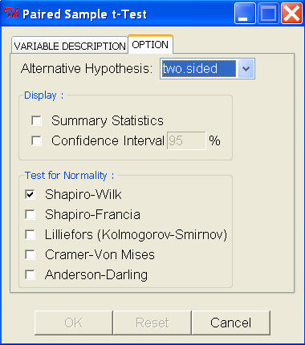
Paired Sample:
Options Tab

Slide 24
t-test
Two Independent Sample

Slide 25
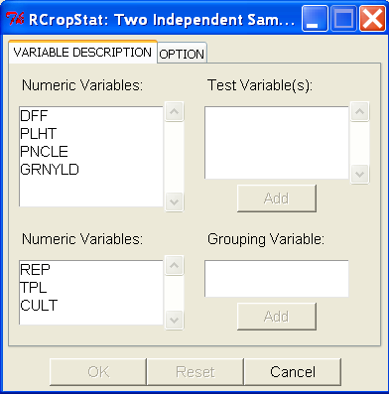
Independent Sample:
Variable Description Tab
Change case of the tab label to Title Case
Only items from numeric variables dialog box can be transferred here; allow multiple selection; if user select item(s) here the variable’s button will be enabled with label Remove
Only numeric variables should be displayed here; allow multiple selection; if user select item(s) here the test variable’s button will be enabled with label Add
Use only one button with initial label Add. Initially, the buttons are disabled.
Change to Factor(s):
Only factor variables should be displayed here; user can select one item only; if user select an item here and the Grouping Variable dialog box is empty, the grouping variable’s button will be enabled with label Add
Only one item can be transferred here and should came from the Factors dialog box; check if the item has two levels only ;if user select the item here the variable’s button will be enabled with label Remove

Slide 26
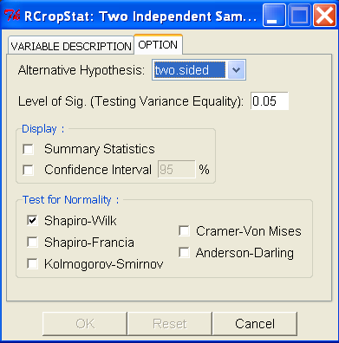
Independent Sample:
Options Tab
Possible values
for Alternative
Hypothesis:
Valid values is between 0.01 to 0.10
Initially disabled; will be enabled if the Confidence Interval checkbox is tick; default value is 95; Valid values is between 90 to 99
Initial state is disabled; it will be enabled if at there is least one item in the Test Variable(s) dialog box (located in the 1st tab)
Initial state is disabled; it will be enabled if there is a change from the initial display

Slide 27
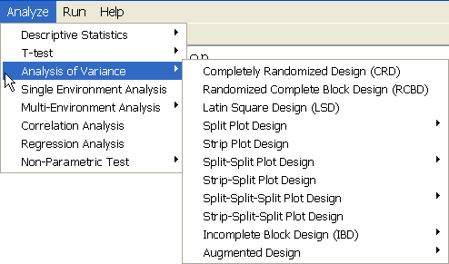
Analysis of Variance Submenu
…
…
…
…
…
…

Slide 28
Analysis of Variance
Completely Randomized Design

Slide 29
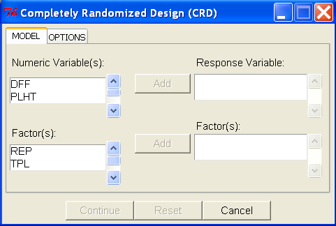
Completely Randomized Design :
Model Specification Tab
Only items from numeric variables dialog box can be transferred here; allow multiple selection; if user select item(s) here the variable’s button will be enabled with label Remove
Only numeric variables should be displayed here; allow multiple selection; if user select item(s) here the test variable’s button will be enabled with label Add
Only factor variables should be displayed here; allow multiple selection; if user select an item(s) here Factor(s) button will be enabled with label Add
Only items from the Factor(s) dialog box can be transferred here; if user select item(s) here the factor(s) button will be enabled with label Remove
Note: (Applicable to all dialog box in the Analysis of Variance)
Change case of the tab label to Title Case
Change MODEL to Model Specification
Change Response Variable to Response Variable(s)
Height of Numeric Variable(s) dialog box & Response Variable(s) dialog box should be the same
Height of Factor(s) dialog box (left hand side) should start from the Factor(s) dialog box (right hand side) until the last dialog box on the right hand side.

Slide 30
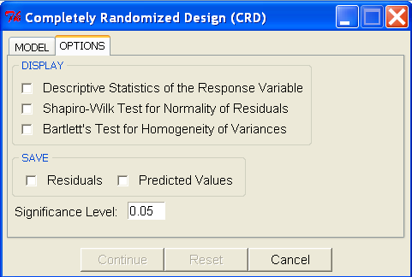
Completely Randomized Design :
Options Tab
Note: (Applicable to all dialog box in the Analysis of Variance)
The option tab is the same for all submenu in Analysis of Variance
Continue button will be enabled if all dialog boxes in the right hand side of the Model Specification tab have an entry and the significance level text box entry is not empty.
For the reimplementation make the Reset button enabled
Default value is 0.05. Valid value is between 0.01 to 0.10

Slide 31
Analysis of Variance
Randomized Complete Block Design

Slide 32
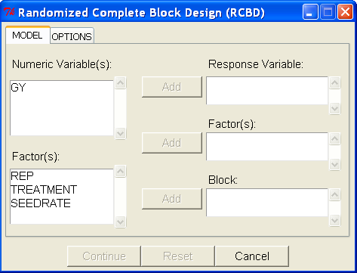
Randomized Complete Block Design :
Model Specification Tab
Only numeric variables should be displayed here; allow multiple selection; if user select item(s) here the test variable’s button will be enabled with label Add
Same specification as the Response Variable in CRD
Same specification as the Factor in CRD
Only factor variables should be displayed here; allow multiple selection; if user select one item and the Block dialog box is empty, the block button will be enabled with label Add; if user select at least one item here Factor(s) button will be enabled with label Add
Only one item from the Factor(s) dialog box can be transferred here; if user select the item here the Block button will be enabled with label Remove

Slide 33
Analysis of Variance
Latin Square Design

Slide 34
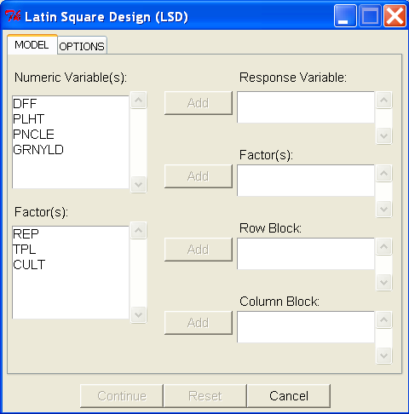
Latin Square Design :
Model Specification Tab
Only numeric variables should be displayed here; allow multiple selection; if user select item(s) here the test variable’s button will be enabled with label Add
Same specification as the Response Variable in CRD
Same specification as the Factor in CRD
Only factor variables should be displayed here; allow multiple selection; if user select one item and the Row Block/Column Block dialog box is empty, the corresponding button will be enabled with label Add; if user select at least one item here Factor(s) button will be enabled with label Add
Only one item from the Factor(s) dialog box can be transferred here; if user select the item here the corresponding button will be enabled with label Remove

Slide 35
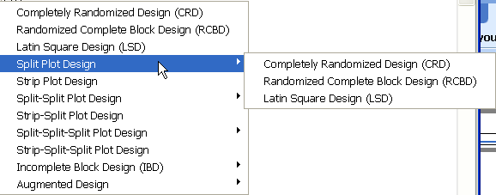
Analysis of Variance Submenu
Split Plot Design Submenu

Slide 36
Analysis of Variance
Split Plot Design
Completely Randomized Design

Slide 37
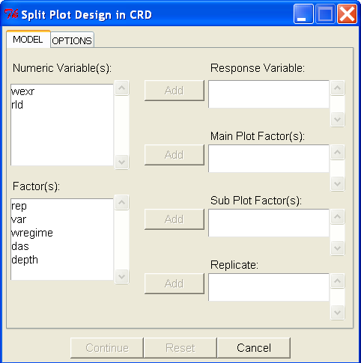
Split Plot Design CRD
Model Specification Tab
Only numeric variables should be displayed here; allow multiple selection; if user select item(s) here the test variable’s button will be enabled with label Add
Same specification as the Response Variable in CRD
Only factor variables should be displayed here; allow multiple selection; if user select one item and the Replicate dialog box is empty, the replicate button will be enabled with label Add; if user select at least one item here, all Factor(s) button will be enabled with label Add
Same specification as the Factor in CRD
Same specification as the Block in RCBD

Slide 38
Analysis of Variance
Split Plot Design
Randomized Complete Block Design

Slide 39
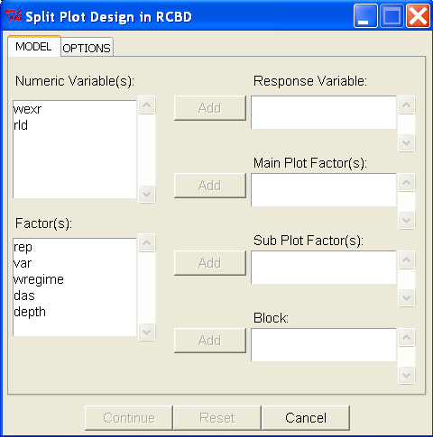
Split Plot Design RCBD
Model Specification Tab
Only numeric variables should be displayed here; allow multiple selection; if user select item(s) here the test variable’s button will be enabled with label Add
Same specification as the Response Variable in CRD
Only factor variables should be displayed here; allow multiple selection; if user select one item and the Block dialog box is empty, the replicate button will be enabled with label Add; if user select at least one item here, all Factor(s) button will be enabled with label Add
Same specification as the Factor in CRD
Same specification as the Block in RCBD

Slide 40
Analysis of Variance
Split Plot Design
Latin Square Design

Slide 41
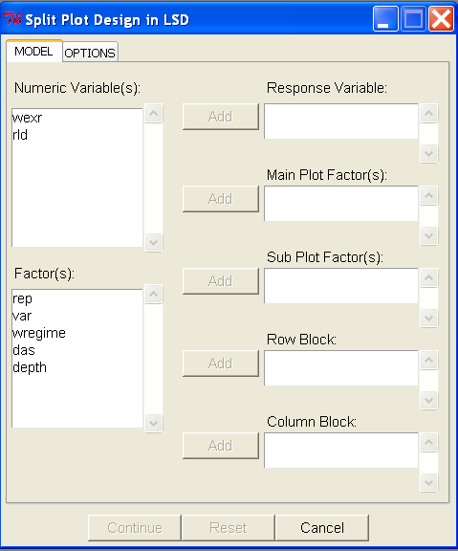
Split Plot Design LSD
Model Specification Tab
Only numeric variables should be displayed here; allow multiple selection; if user select item(s) here the test variable’s button will be enabled with label Add
Same specification as the Response Variable in CRD
Only factor variables should be displayed here; allow multiple selection; if user select one item and the Block dialog box is empty, the replicate button will be enabled with label Add; if user select at least one item here, all Factor(s) button will be enabled with label Add
Same specification as the Factor in CRD
Same specification as the Block in RCBD

Slide 42
Analysis of Variance
Strip Plot

Slide 43
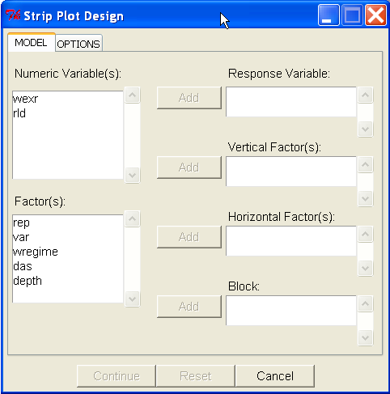
Strip Plot Design
Model Specification Tab
Only numeric variables should be displayed here; allow multiple selection; if user select item(s) here the test variable’s button will be enabled with label Add
Same specification as the Response Variable in CRD
Only factor variables should be displayed here; allow multiple selection; if user select one item and the Block dialog box is empty, the replicate button will be enabled with label Add; if user select at least one item here, all Factor(s) button will be enabled with label Add
Same specification as the Factor in CRD
Same specification as the Block in RCBD

Slide 44
Analysis of Variance Submenu
Split-Split Plot Design Submenu

Slide 45
Analysis of Variance
Split-Split Plot Design
Completely Randomized Design

Slide 46
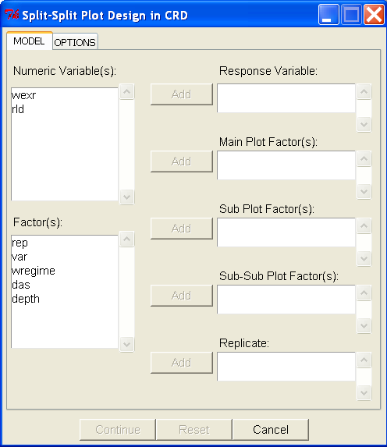
Split Split Plot Design CRD
Model Specification Tab
Only numeric variables should be displayed here; allow multiple selection; if user select item(s) here the test variable’s button will be enabled with label Add
Same specification as the Response Variable in CRD
Only factor variables should be displayed here; allow multiple selection; if user select one item and the Replicate dialog box is empty, the replicate button will be enabled with label Add; if user select at least one item here, all Factor(s) button will be enabled with label Add
Same specification as the Factor in CRD
Same specification as the Block in RCBD

Slide 47
Analysis of Variance
Split-Split Plot Design
Randomized Complete Block Design

Slide 48
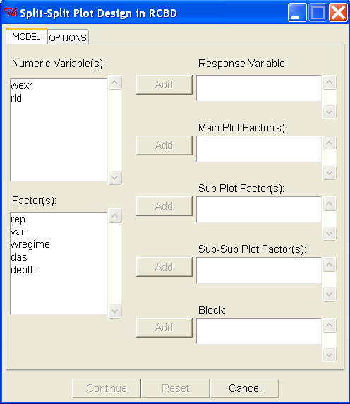
Split- Split Plot Design RCBD
Model Specification Tab
Only numeric variables should be displayed here; allow multiple selection; if user select item(s) here the test variable’s button will be enabled with label Add
Same specification as the Response Variable in CRD
Only factor variables should be displayed here; allow multiple selection; if user select one item and the Block dialog box is empty, the replicate button will be enabled with label Add; if user select at least one item here, all Factor(s) button will be enabled with label Add
Same specification as the Factor in CRD
Same specification as the Block in RCBD

Slide 49
Analysis of Variance
Split-Split Plot Design
Latin Square Design

Slide 50
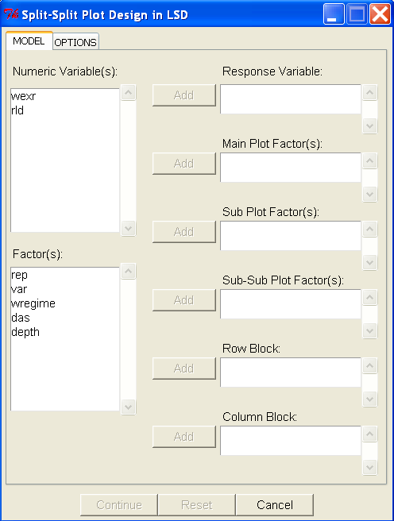
Split- Split Plot Design LSD
Model Specification Tab
Only numeric variables should be displayed here; allow multiple selection; if user select item(s) here the test variable’s button will be enabled with label Add
Same specification as the Response Variable in CRD
Only factor variables should be displayed here; allow multiple selection; if user select one item and the Block dialog box is empty, the replicate button will be enabled with label Add; if user select at least one item here, all Factor(s) button will be enabled with label Add
Same specification as the Factor in CRD
Same specification as the Block in RCBD

Slide 51
Analysis of Variance
Strip-Split Plot

Slide 52
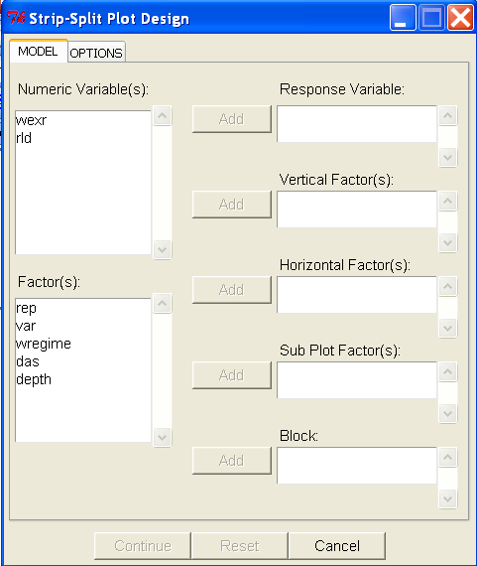
Strip- Split Plot Design
Model Specification Tab
Only numeric variables should be displayed here; allow multiple selection; if user select item(s) here the test variable’s button will be enabled with label Add
Same specification as the Response Variable in CRD
Only factor variables should be displayed here; allow multiple selection; if user select one item and the Block dialog box is empty, the replicate button will be enabled with label Add; if user select at least one item here, all Factor(s) button will be enabled with label Add
Same specification as the Factor in CRD
Same specification as the Block in RCBD

Slide 53
Analysis of Variance Submenu
Split-Split-Split Plot Design Submenu

Slide 54
Analysis of Variance
Split-Split-Split Plot Design
Completely Randomized Design

Slide 55
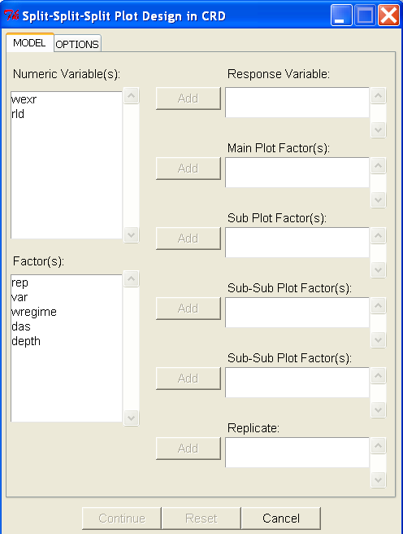
Split- Split- Split Plot Design CRD
Model Specification Tab
Only numeric variables should be displayed here; allow multiple selection; if user select item(s) here the test variable’s button will be enabled with label Add
Same specification as the Response Variable in CRD
Only factor variables should be displayed here; allow multiple selection; if user select one item and the Replicate dialog box is empty, the replicate button will be enabled with label Add; if user select at least one item here, all Factor(s) button will be enabled with label Add
Same specification as the Factor in CRD
Same specification as the Block in RCBD

Slide 56
Analysis of Variance
Split-Split-Split Plot Design
Randomized Complete Block Design

Slide 57

Split- Split- Split Plot Design RCBD
Model Specification Tab
Only numeric variables should be displayed here; allow multiple selection; if user select item(s) here the test variable’s button will be enabled with label Add
Same specification as the Response Variable in CRD
Only factor variables should be displayed here; allow multiple selection; if user select one item and the Block dialog box is empty, the replicate button will be enabled with label Add; if user select at least one item here, all Factor(s) button will be enabled with label Add
Same specification as the Factor in CRD
Same specification as the Block in RCBD

Slide 58
Analysis of Variance
Split-Split-Split Plot Design
Latin Square Design

Slide 59
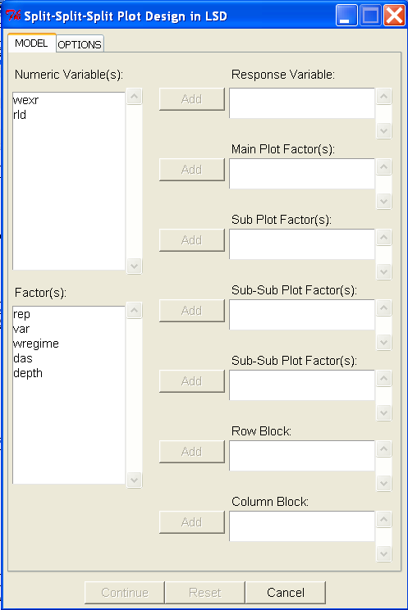
Split- Split- Split Plot Design LSD
Model Specification Tab
Only numeric variables should be displayed here; allow multiple selection; if user select item(s) here the test variable’s button will be enabled with label Add
Same specification as the Response Variable in CRD
Same specification as the Factor in CRD
Only factor variables should be displayed here; allow multiple selection; if user select one item and the Block dialog box is empty, the replicate button will be enabled with label Add; if user select at least one item here, all Factor(s) button will be enabled with label Add
Same specification as the Block in RCBD

Slide 60
Analysis of Variance
Strip-Split-Split Plot

Slide 61
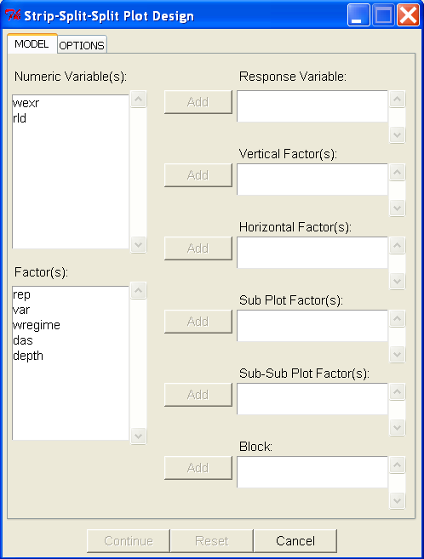
Strip-Split-Split Plot Design
Model Specification Tab
Only numeric variables should be displayed here; allow multiple selection; if user select item(s) here the test variable’s button will be enabled with label Add
Same specification as the Response Variable in CRD
Only factor variables should be displayed here; allow multiple selection; if user select one item and the Block dialog box is empty, the replicate button will be enabled with label Add; if user select at least one item here, all Factor(s) button will be enabled with label Add
Same specification as the Factor in CRD
Same specification as the Block in RCBD

Slide 62
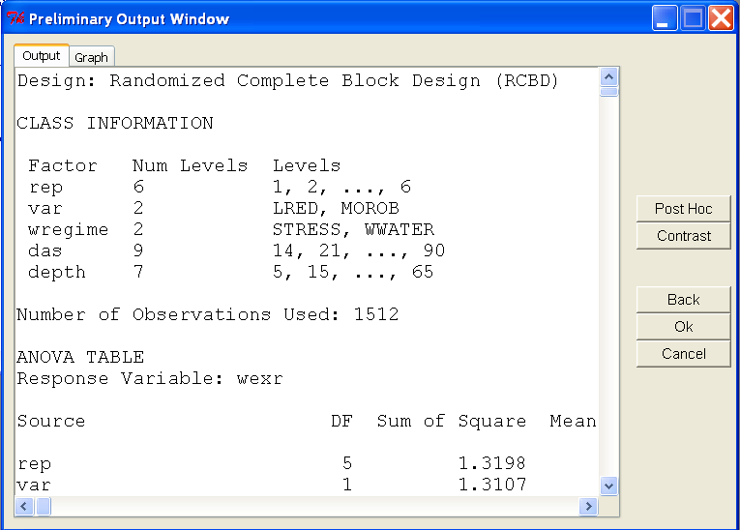
Preliminary Output Window
- this is the window that will be opened after the user click the Continue button in the Analysis of Variance dialog box

Slide 63
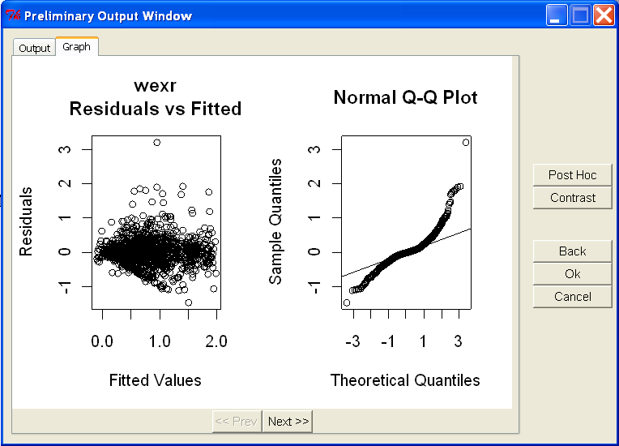
Preliminary Output Window
- this is the window that will be opened after the user click the Continue button in the Analysis of Variance dialog box

Slide 64
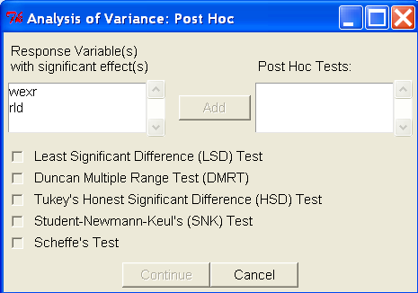
Preliminary Output Window: Post Hoc button
The post hoc button is only enabled if there is at least one response variable with a significant effect
Only variables with significant effect will be displayed here; allow multiple selection; if user select item(s) here the Post Hoc Tests button will be enabled with label Add
Allow multiple selection; if user select item(s) here, the Post Hoc Tests button will be enabled with label Remove
By default, this button is disabled. It will be enabled if there is at least one item in the Post Hoc Tests dialog box and at least one check box is tick

Slide 65
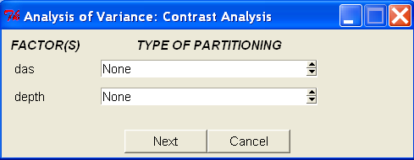
Preliminary Output Window: Contrast button… part 1
The contrast button is only enabled if there is there is at least one factor with more than two levels
Only factors with more than two levels will be displayed here
Choices in Type of Partitioning:
None
Compare with control
Orthogonal Polynomial Contrast
  user can only choose this if the levels of the factors are numeric
User Specified Contrast

Slide 66
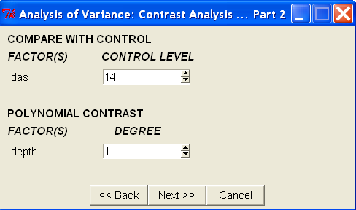
Preliminary Output Window: Contrast button… part 2
The contrast button is only enabled if there is there is at least one factor with more than two levels
Case 1: Compare with Control
Case 2: Orthogonal Polynomial Contrast
For Compare with Control: Choices will be the levels of the factor. Default value is the first level of the factor
For Polynomial Contrast: Choices 1 to level of the factor - 1. Default value is1

Slide 67
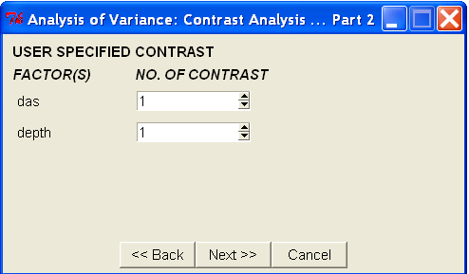
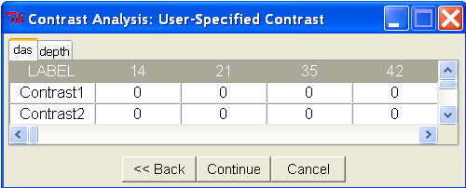
Preliminary Output Window: Contrast button… part 2
Case 3: User-Specified Contrast
For User Specified Contrast: Choices 1 to level of the factor - 1. Default value is1
Levels of the factor
Default value is 0. For each row the sum of the coefficient should be equal to 0.

Slide 68
Preliminary Output Window: Other buttons
If the user click this button, the Preliminary Output Window will be closed and the Analysis of Variance dialog box will be visible.
If the user click this button, the Preliminary Output Window and the Analysis of Variance dialog box will be closed.
If the user click this button, the Preliminary Output Window and the Analysis of Variance dialog box will be closed. No analysis will be process

Slide 69
Analysis of Variance Submenu
Incomplete Block Design Submenu

Slide 70
Analysis of Variance
Incomplete Block Design
Balanced Incomplete Block

Slide 71
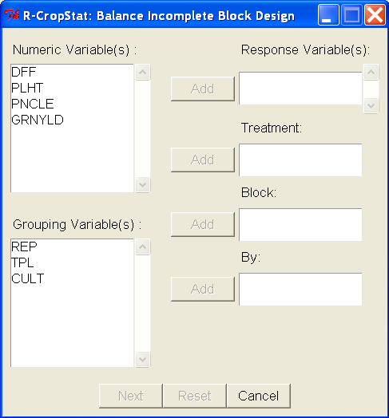
Balanced Incomplete Block Design
Model Specification Tab
Items must come from the Numeric Variable(s) dialog box; allow multiple selection; if user select item(s) the response variable button will be enabled and the label will be Remove
Only numeric variables should be displayed here; allow multiple selection; if user select item(s) here the test variable’s button will be enabled with label Add
user can only transferred one item at a time & must come from the Factor dialog box; if user select the item the corresponding button will be enabled and the label will be Remove
Change to Factor(s):
Only factor variables should be displayed here; single selection; if user select item here, Add buttons of the EMPTY fields [Treatment/Block] are enabled;
delete

Slide 72
Analysis of Variance Submenu
Augmented Design Submenu

Slide 73
Analysis of Variance
Augmented Design
Randomized Complete Block Design

Slide 74
Analysis of Variance
Augmented Design
Latin Square Design

Slide 75
Correlation Analysis Submenu

Slide 76
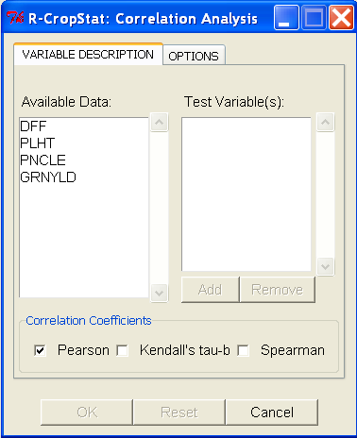
Correlation Analysis:
Variable Description Tab
Change the case the tab label to Title Case
Allow multiple selection; if user select item(s) here the variable’s button will be enabled with label Remove
Change label to: Numeric Variable(s):
Only numeric variables should be displayed here; allow multiple selection; if user select item(s) here the button will be enabled with label Add
Use only one button with initial label Add. Initially, the button is disabled.
Initially this button is disabled; It will be enabled if there is a change from the initial display
Initially this button is disabled; it will be enabled if there is at least two items in the Test Variable(s) dialog box and at least one item in the Correlation Coefficients is chosen

Slide 77
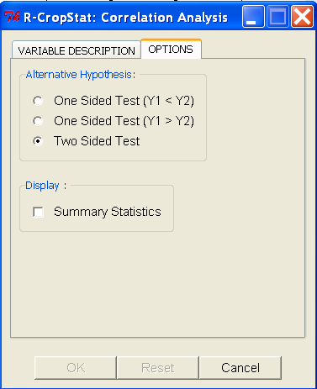
Correlation Analysis:
Options Tab
Change to:
Less than
Greater than
Not Equal
Graph:
Add
Scatterplot

Slide 78
Regression Analysis Submenu

Slide 79
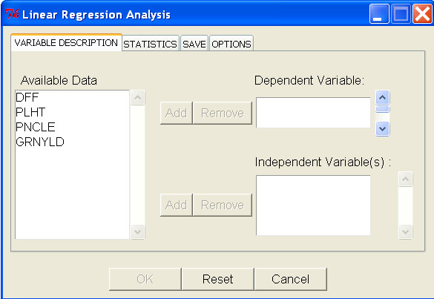
Linear Regression Analysis:
Variable Description Tab
allow multiple selection; if user select item(s) here the dependent variable(s) button will be enabled with label Remove
Change the case the tab label to Title Case
Only numeric variables should be displayed here; allow multiple selection; if user select item(s) here the button will be enabled with label Add
Use only one button with initial label Add. Initially, the buttons are disabled.
allow multiple selection; if user select item(s) here the independent variable(s) button will be enabled with label Remove

Slide 80
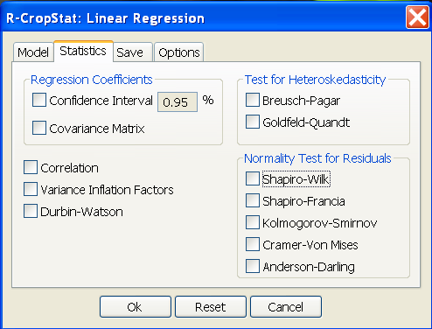
Linear Regression Analysis:
Variable Description Tab

Slide 81
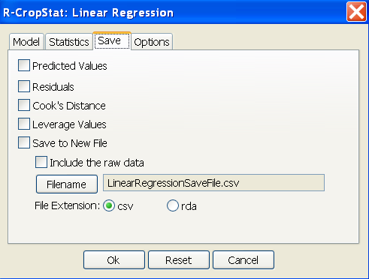
Linear Regression Analysis:
Variable Description Tab
Delete

Slide 82
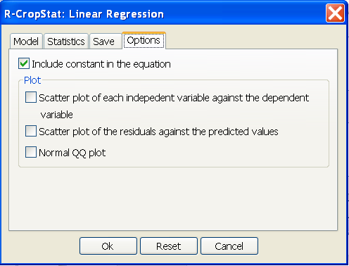
Linear Regression Analysis:
Variable Description Tab

Slide 83
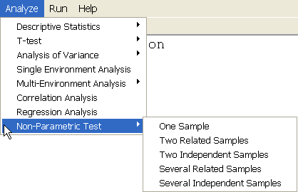
Non-Parametric Test Submenu
…
…
…
…
…

Slide 84
Non-Parametric Test
One Sample

Slide 85

One Sample Nonparametric Test:
Variable Description Tab
Only numeric variables should appear here; allow multiple selection; if user select item(s) here the button will be enabled with label Add
allow multiple selection; if user select item(s) here the button will be enabled with label Remove
Use only one button; initially the button is disabled with label Add
Possible value: numeric
Possible values
for Alternative
Hypothesis:

Slide 86
Non-Parametric Test
Two Related Sample

Slide 87

Two Related Samples Nonparametric Test :
Variable Description Tab
allow multiple selection; if user select item(s) here the button will be enabled with label Remove
Only numeric variables should appear here; allow multiple selection; if user select item(s) here the button will be enabled with label Add
Use only one button; initially the button is disabled with label Add
Possible values
for Alternative
Hypothesis:

Slide 88
Non-Parametric Test
Two Independent Sample

Slide 89

Test for Two Independent Samples Nonparametric Test:
Variable Description Tab
Items should come from the numeric variable dialog box; allow multiple selection; if user select item(s) here the Test variable(s) button will be enabled with label Remove
Only numeric variables should appear here; allow multiple selection; if user select item(s) here the button will be enabled with label Add
Use only one button; initially the button is disabled with label Add
Only factor variables should appear here; if user select item here the grouping variable button will be enabled with label Add
One item only from the factor dialog box; check if it has two items only
Possible values
for Alternative
Hypothesis:

Slide 90
Non-Parametric Test
Several Related Sample

Slide 91

Test for Several Related Samples Nonparametric Test:
Variable Description Tab
Change to Numeric Variable(s):
Items should come from the numeric variable dialog box; allow multiple selection; if user select item(s) here the Test variable(s) button will be enabled with label Remove
Only numeric variables should appear here; allow multiple selection; if user select item(s) here the button will be enabled with label Add
Use only one button; initially the button is disabled with label Add
Only factor variables should appear here; if user select item here the grouping variable button will be enabled with label Add
One item only from the factor dialog box; check if it has two or more levels
Will be enabled if all dialog box in the right side are not empty

Slide 92
Non-Parametric Test
Several Independent Sample

Slide 93

Test for Several Independent Samples Nonparametric Test:
Variable Description Tab
Change to Numeric Variable(s):
Items should come from the numeric variable dialog box; allow multiple selection; if user select item(s) here the Test variable(s) button will be enabled with label Remove
Only numeric variables should appear here; allow multiple selection; if user select item(s) here the button will be enabled with label Add
Use only one button; initially the button is disabled with label Add
Only factor variables should appear here; if user select item here the grouping variable button will be enabled with label Add
One item only from the factor dialog box; check if it has two or more levels
Will be enabled if test variable(s) and grouping variable dialog box are not empty

